Slide 1
Assignment 1
IE1020 – Network Fundamentals
Y1.S2.WD.CSNE.01.1 – Group 2

Slide 2
Group Members
Name | Student ID
D R WICKRAMA ARACHCHI | IT22360496
I D N K SIRIWARDHANA | IT22323798
K C S P PERERA | IT22324306
W M S L WICKRAMASINGHE | IT22365378
W V A D N BINATH | IT22311122

Slide 3
Scenario
XYZ University is a large university with 7 branches located throughout a country.
It has over 50,000 students, faculty, and staff members who rely heavily on the university's network for research, communication, and learning.

Slide 4
Scenario
The proposed network design includes a core network, distribution network, access network, wireless network, security, management, backup and redundancy measures, and a centralized network management system.

Slide 5
Assumptions
Estimated end-user devices to be 9000 PCs, and 150 wireless routers.
The institute would need 4.5 million USD to build a large web with backup and redundancy to sustain growth.

Slide 6
Assumptions
Campuses are dispersed, yet close enough to provide adequate connectivity.

Slide 7
Logical Topology Design

Slide 8
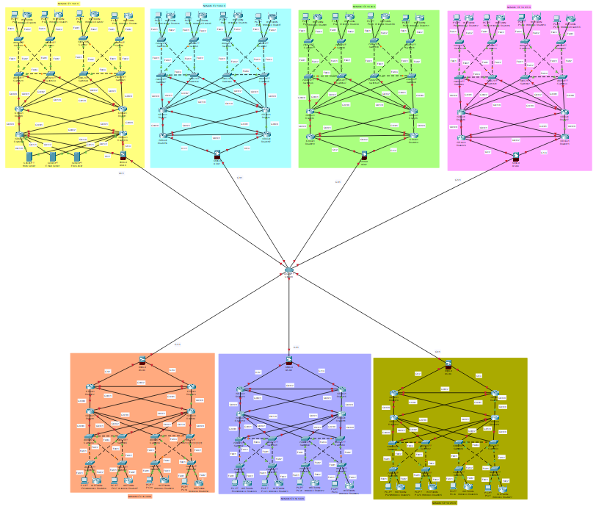

Slide 9
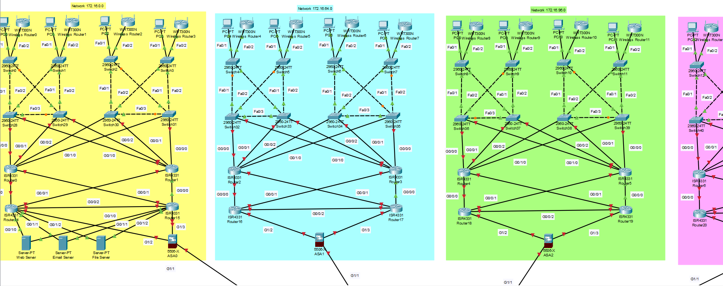

Slide 10
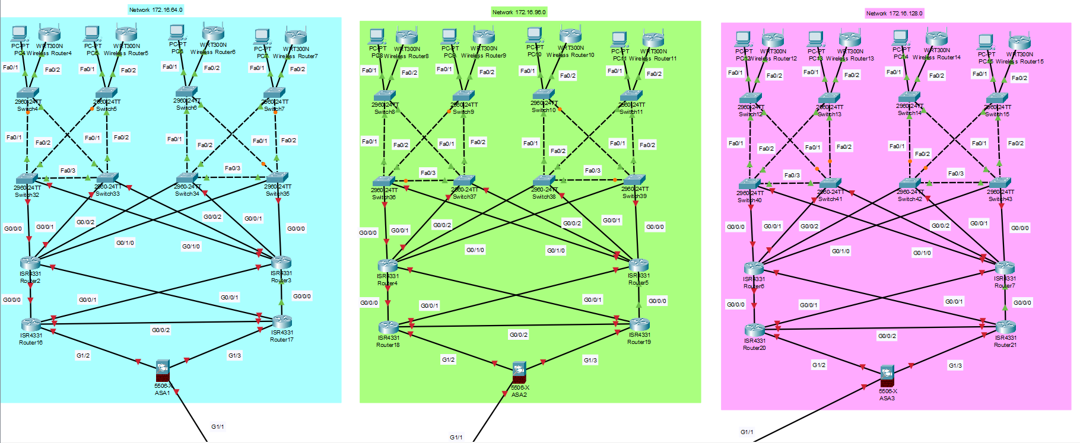

Slide 11
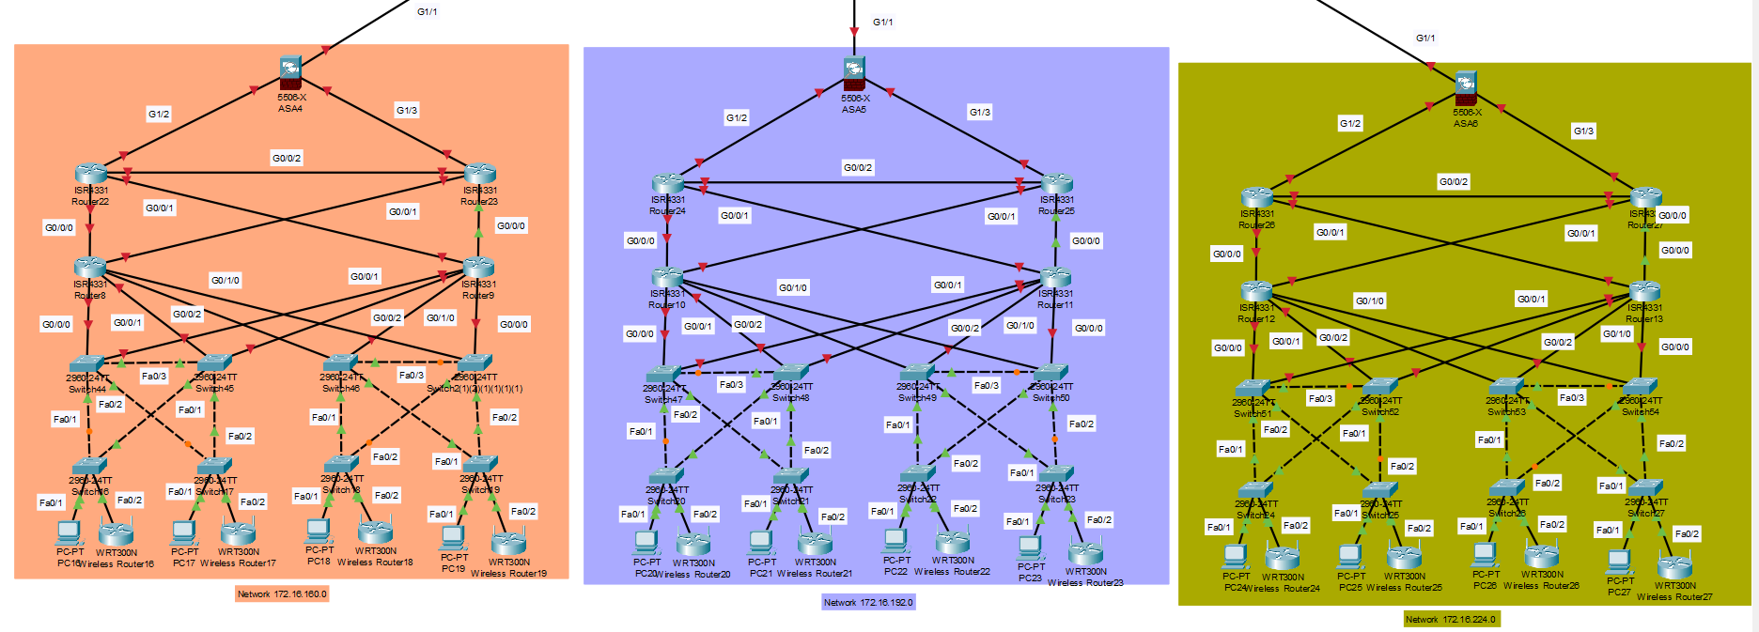

Slide 12
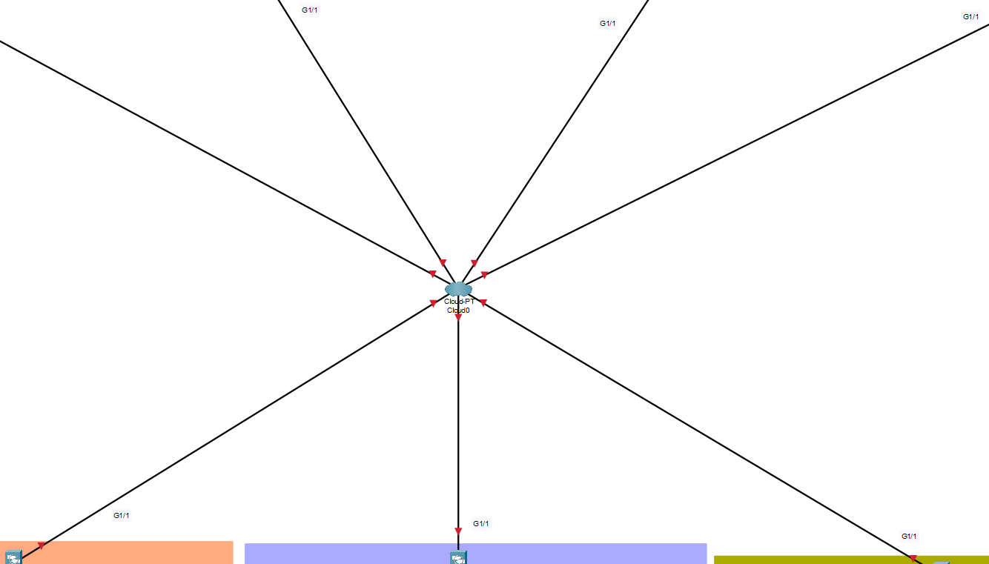

Slide 13
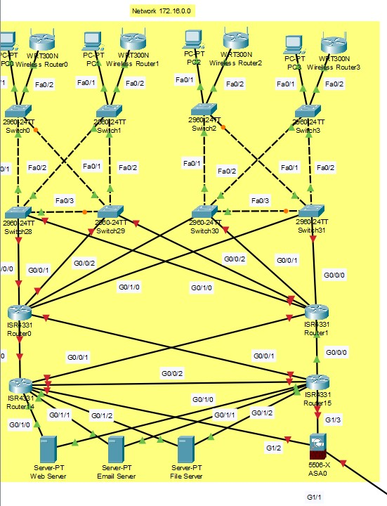

Slide 14
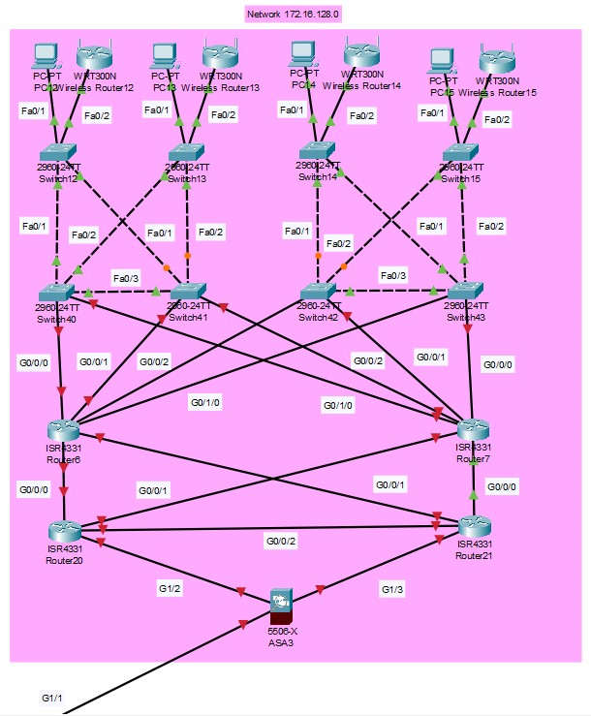

Slide 15
Physical Topology Design

Slide 16
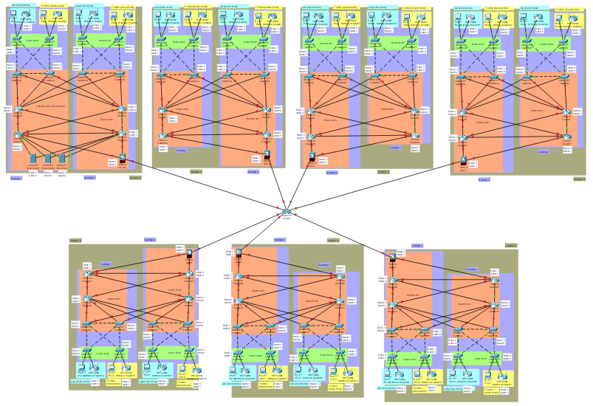

Slide 17
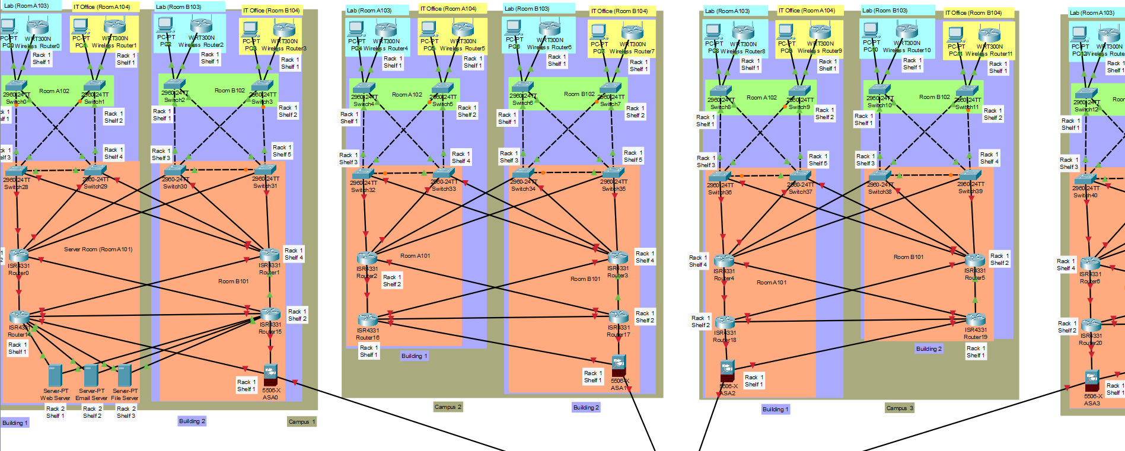

Slide 18
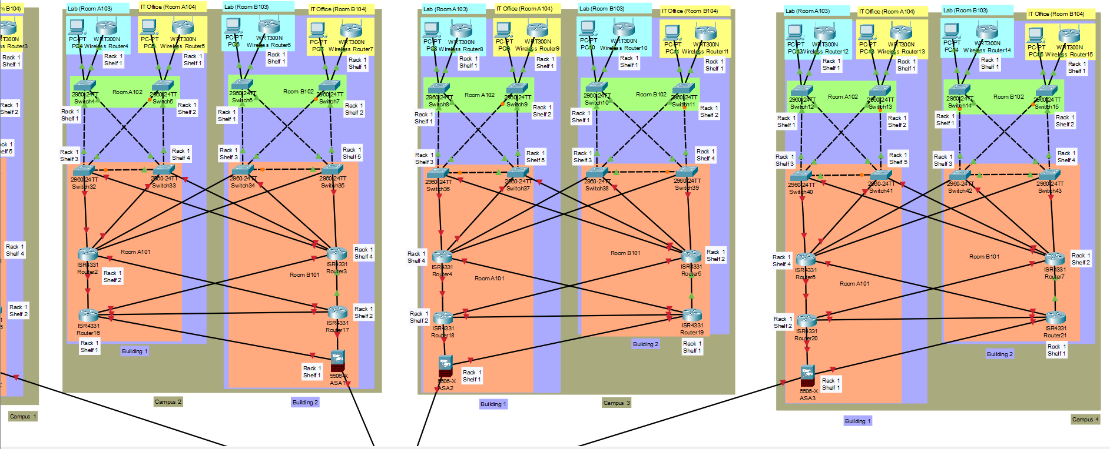

Slide 19
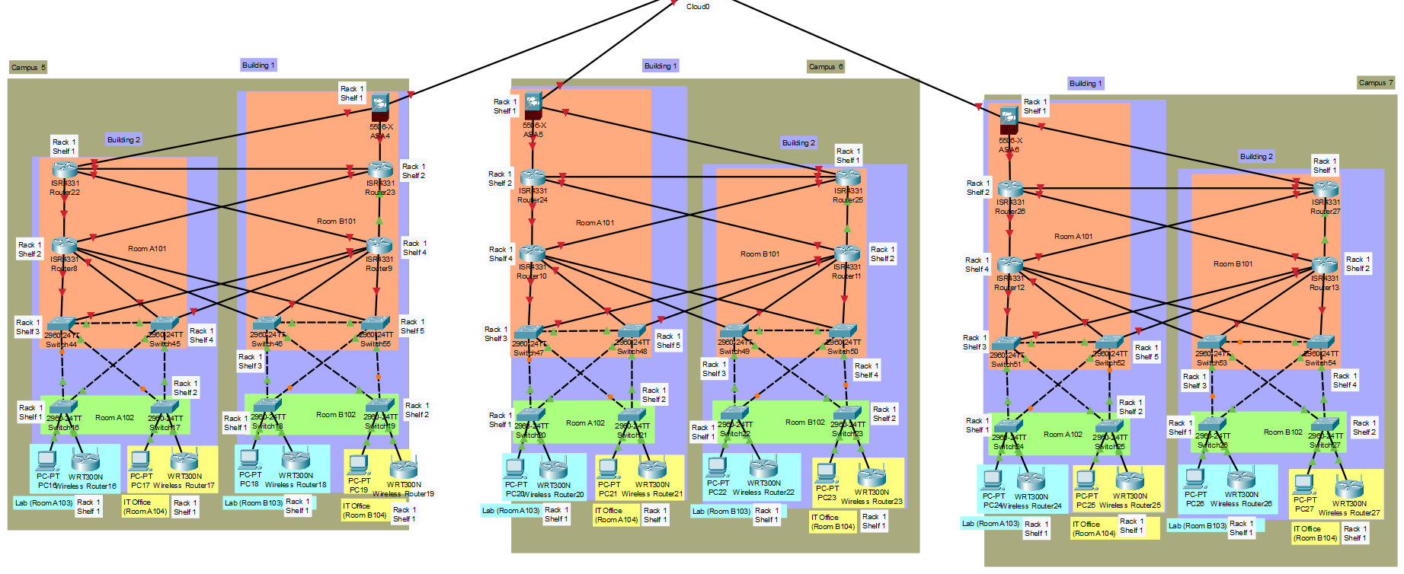

Slide 20
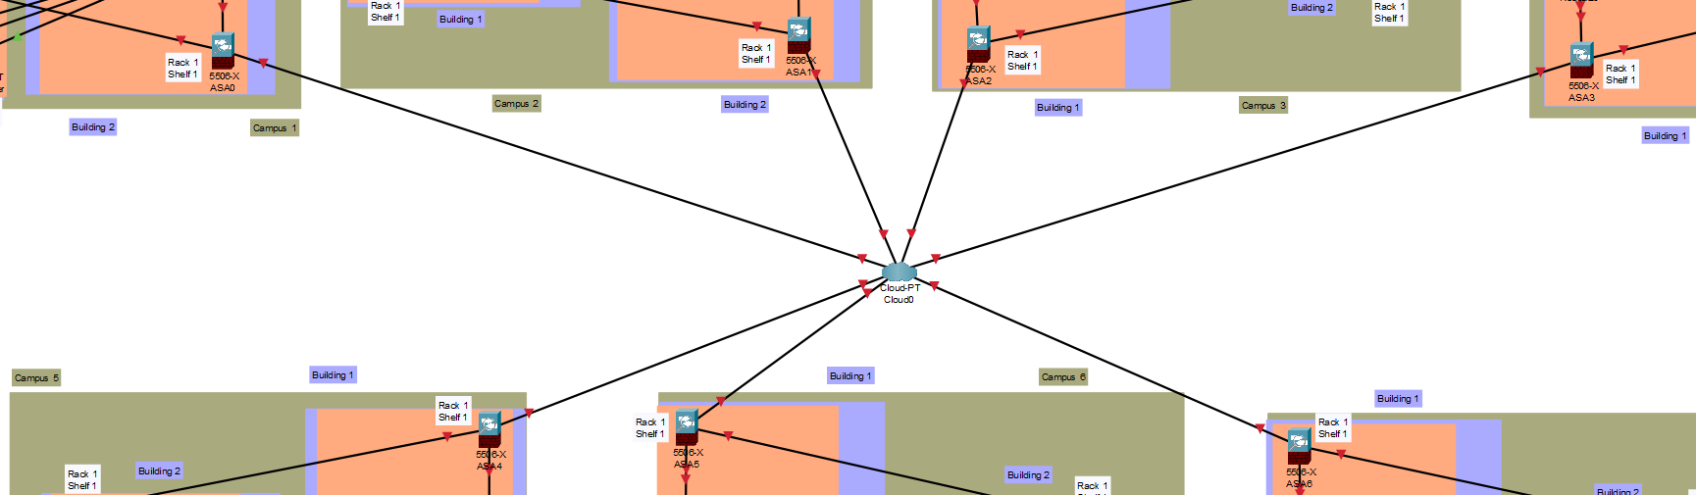

Slide 21
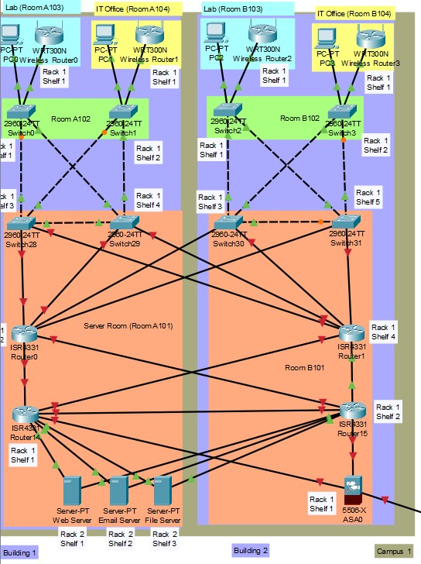

Slide 22
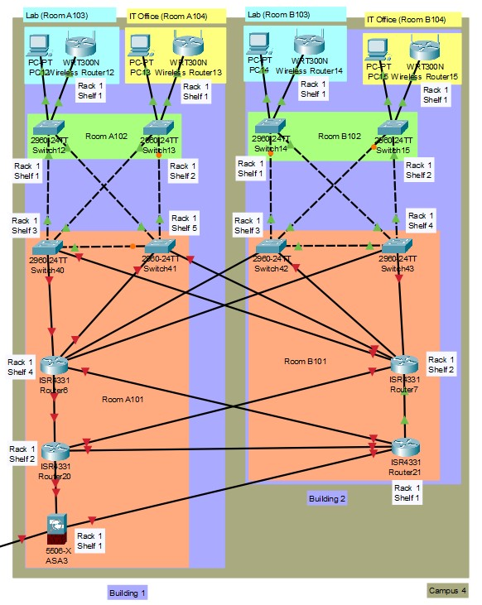

Slide 23
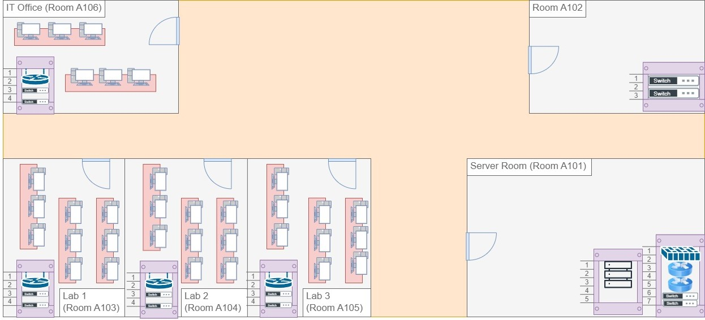

Slide 24
Appropriate Devices with Justifications

Slide 25
Core Network
The Cisco ASR 9000 Series Router is a high-density, high performance edge platform suitable for mass-scale networks.
It provides operators with a long-term growth platform that scales ahead of demand, protects investments, accelerates service agility, and protects critical infrastructure.

Slide 26
Distribution Network
Cisco 4000 Series Integrated Services Routers provide application visibility, network services, simplified management, threat protection, and application visibility to gain actionable insights.

Slide 27
Distribution Network
Cisco Catalyst 9500 Series switches provide network protection, reduce attack surface, enhance malware detection, secure network IoT readiness, simplify cloud environment, and support advanced routing and infrastructure services.

Slide 28
Access Network
Cisco Catalyst 9300 Series switches offer a superior network and service experience, advanced application hosting, and converged wired and wireless access.

Slide 29
Wireless Network
Cisco Aironet 4800 Series access points provide high-speed Wi-Fi, advanced features, and security.

Slide 30
Security
Palo Alto Networks PA-1400 Series Firewalls provide centralized management, configuration, and visibility.

Slide 31
Management
SolarWinds Network Performance Monitor provides real-time monitoring, performance analysis, configuration management, and alerting.

Slide 32
Appropriate Media Types with Justifications

Slide 33
Core Network
XYZ University can achieve a balance between cost-effectiveness and network performance by deploying EoC for the core layer, ensuring dependable and high-speed connectivity.
Ethernet Cat6a cables are used to connect the core layer to an Internet Service Provider.

Slide 34
Distribution Network
Ethernet Cat6a cables provide high-speed internet, encryption, and authentication.

Slide 35
Access Network
Ethernet Cat6a cables offer consistent communication for end-user devices, are inexpensive and easy to install, and are suitable for campus deployments.

Slide 36
Wireless Network
WAPs send signals as EM waves via free space.
This transmission media is also known as unguided/wireless media.

Slide 37
LAN and WAN Technologies

Slide 38
LAN Technologies
Ethernet offers high-speed communication, dependability, and compatibility.

Slide 39
WAN Technologies
Metro Ethernet provides safe and dependable inter-campus connectivity with minimal latency.

Slide 40
Appropriate Protocols with Justifications

Slide 41
Physical Layer
Ethernet: Twisted pair cables are a cost-effective physical layer option for XYZ University's network.
Wireless: Wi-Fi and other wireless protocols are needed to link mobile devices across campuses.

Slide 42
Data Link Layer
Ethernet: It is a standard protocol for dependable data transmission
Switch: Switches are essential for fast, secure data transmission to only the intended recipients.

Slide 43
Network Layer
IP and ICMP are used for packet addressing, routing, network administration, problem reporting, and diagnostics, respectively.

Slide 44
Transport Layer
TCP: TCP is reliable for error-free data transfer.
UDP: UDP is used for speed and efficiency.

Slide 45
Session Layer
Sockets and WinSock enable communication between hosts at the session layer.

Slide 46
Presentation Layer
SSL and MPEG ensure data confidentiality and integrity, important for university-related multimedia applications.

Slide 47
Application Layer
HTTPS: HTTPS is used to securely access online resources and web-based applications.
DNS: DNS is used to convert domain names into IP addresses, allowing people to access websites using human readable names.

Slide 48
Private IP Addressing Schema

Slide 49
Subnet Name | Required IPs | Required Bits | Network Address | Slash | Mask | Usable Range | Broadcast Address
Campus 1 | 12000 | 16382 | 172.16.0.0 | /18 | 255.255.192.0 | 172.16.0.1 - 172.16.63.254 | 172.16.63.255
Campus 2 | 8000 | 8190 | 172.16.64.0 | /19 | 255.255.224.0 | 172.16.64.1 - 172.16.95.254 | 172.16.95.255
Campus 3 | 7000 | 8190 | 172.16.96.0 | /19 | 255.255.224.0 | 172.16.96.1 - 172.16.127.254 | 172.16.127.255
Campus 7 | 7000 | 8190 | 172.16.128.0 | /19 | 255.255.224.0 | 172.16.128.1 - 172.16.159.254 | 172.16.159.255
Campus 4 | 6500 | 8190 | 172.16.160.0 | /19 | 255.255.224.0 | 172.16.160.1 - 172.16.191.254 | 172.16.191.255
Campus 5 | 5500 | 8190 | 172.16.192.0 | /19 | 255.255.224.0 | 172.16.192.1 - 172.16.223.254 | 172.16.223.255
Campus 6 | 4000 | 4094 | 172.16.224.0 | /20 | 255.255.240.0 | 172.16.224.1 - 172.16.239.254 | 172.16.239.255

Slide 50
Thank You!

